Slide 1
Pairs-Trading (CH9) Risk Arbitrage Mechanics

Slide 2
Definition of Risk Arbitrage
Risk arbitrage in its general connotation
relates to trading around corporate events that alter the capital structure of a firm.
A broad definition for three types of arbitrage that contain an element of risk
(1) Merger and acquisition arbitrage
(2) Liquidation arbitrage
(3) Pairs trading
Notes:
Liquidation 清算

Slide 3
Introduction
Capital structure:
(1)issuing equity (2)issuing bonds
We prefer to issue equity first,then issuing bond.
Corporate events:
An action udertaken by company that affects its
shareholders and bond holders.
Ex: paying of dividends, stock splits, tender offers, mergers, exchange offers,spinoffs, and recapitalizations.
Notes:
Recapitalizations: 公司資本結構調整，在不影響公司總體股本前提下，調整債務與股本的組合。

Slide 4
Introduction
Trading on the price disparity between the two exchanged securities is termed risk arbitrage.
Of the two securities involved in the exchange, we buy the lower priced security, sell the higher-priced security, and lock in the price difference for our profit.
In the case of recapitalizations and spinoffs, one side of the exchanged securities is issued afresh and cannot be traded before issue. Keeping with the theme of pairs trading, we therefore focus on mergers and exchange offers.

Slide 5
The Deal process
Merger:
The aquirer will negotiate agreement with the Target Board.
Exchange offer
(1) The aquirer will make an offer addressed
to each shareholders.
(2)A hybrid between a merger and a tender-
offer
(3)Through advertisements in the Wall Street Journal and local newspapers.
Process :
尋找 律師訂合約 宣布 經SEC認可 Effective Day 通知股東

Slide 6
Transaction terms
The role of the transaction terms in a deal is to mitigate some of the variability of the price of the bidder stock and try to achieve the objective of paying a specific dollar amount for the target stock.
Fixed Ratio Stock Exchange
Shares of the target are exchanged for shares of the bidder in a fixed exchange ratio.
Fixed Value Stock Exchange
A commonly used approach is to use the average closing price of the bidder stock in the pricing period to determine the exchange ratio.
Sometimes, to prevent manipulation of the closing price by arbitrageurs,we use weighted average price.

Slide 7
Stock and Cash Exchange
Example:
Bidder B pays for target T, 70 percent in stock,30 percent in cash. The share exchange ratio is 0.5; that is, 1/2 a share of B for one share of T. Cash amount paid for the remaining 30 percent is $20. Based on the preceding specification, let us now compute the exchange on a per target stock basis.
Share amount: share percentage × ratio = 0.7 × 0.5 = .35
Cash amount: cash percentage × cash value = 0.3 × $20 = $6.0
Notes:
These sets of transaction terms reduce the dependence of the exchange ratio on the price of the bidder stock, paying partly in cash reduces the amount of equity issued and has an effect on the capital structure of the new entity.

Slide 8
THE DEAL SPREAD
Collars: (adjustment)
Attempt to reeduce the dependence of the exchange ratio to the volatility of stock.
Spread = exchange value of a target share –
current price of target share

Slide 9
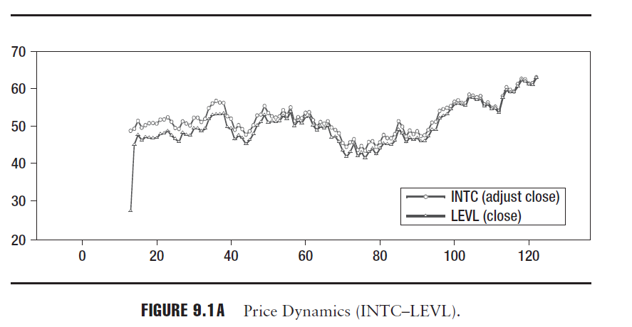
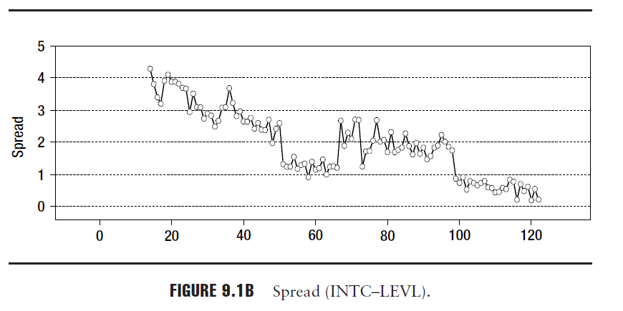
Price
Notes:
一般投資人無此資訊，資金不夠
較多是金融機構，EX:2008以前 許多投資公司有此做法 08後 因為舉債成本過高而作罷
有三個問題點 : 1.圖形 2.水平或垂直整合 3.回補日在effective day 之前

Slide 10
TRADING STRATEGY
The typical trade executed is to short the bidder shares (sell high), buy the target shares (buy low), and pocket the spread. When the deal is completed, the target shares owned are exchanged for bidder shares. These bidder shares are then applied to cover the short position.

Slide 11
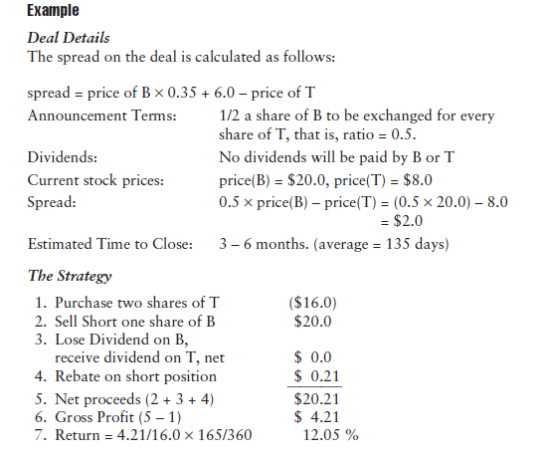
Example

Slide 12
後續
We will illustrate how trading may be done during the pricing period when the exchange ratio is unclear.
Next, we demonstrate how market implied deal break probability can be evaluated using the time series of the spread. (VaR)

